Slide 1
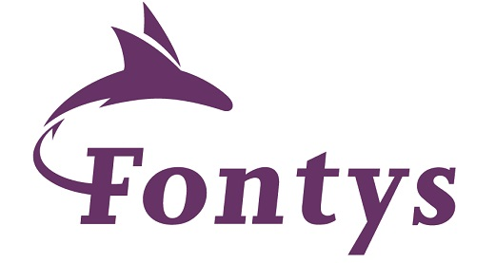

Microservices, Messaging and Apache Kafka - Part One October 2022
Lucas Jellema Architect & CTO AMIS | Conclusion
labs: github.com/lucasjellema/fontys-fall2022-microservices-messaging-kafka-dapr
Notes:
Wat is een microservice? (waarom, problemen met monolitische applicaties, hoe microservice architectuur, generieke voorzieningen & platform voor microservices, data & events als glue tussen microservices)
Hier alvast stilstaan bij het belang van een event broker en een korte intro van Kafka (meer in college 2)
Implementatie van microservices: afhandelen van http requests, consumeren en publiceren van events, doen van http calls: wat zijn activiteiten die iedere microservice moet uitvoeren? (state mgt, pub/sub, secrets, config mgt, aanroepen 3rd party (cloud) services, ..)
Introductie en demo van Dapr.io framework – de personal assistant die iedere applicatie eenvoudig laat aansluiten op generieke voorzieningen én die applicaties (microservices) met elkaar laat interacteren op ontkoppelde wijze; note: ik zal wijzen op de ondersteuning in Dapr.io voor diverse technologieën zoals RabbitMQ, MySQL, Redis
Handson met Dapr – meegeleverde applicaties in Java en C#
Zelf implementeren van microservice – introductie van NodeJS ;
Handson: afbouwen eenvoudige services in NodeJs en via Dapr.io interactie met elkaar en met generieke voorzieningen

Slide 2




80 colleagues, located in Nieuwegein
Founded in 1991 by students from University of Twente – Aircraft Maintenance Information System (AMIS)
the core of what we do: working with Data.
partnering with peers and companies in several countries
Lucas Jellema (2002)
Cloud Solution Architect & CTO
lucas.jellema@amis.nl | technology.amis.nl | @lucasjellema | lucas-jellema

Slide 3
Data & Application Integration
cloud, DevOps, PaaS, streaming, microservices, Software Studio, database, software engineering
web applications
Data Engineering, Data Analytics (& Data Science)
Oracle, Microsoft Azure, open source, Java, SQL, NodeJS, Python, Kafka React/Angular
Internet of Things

Slide 4







Slide 5






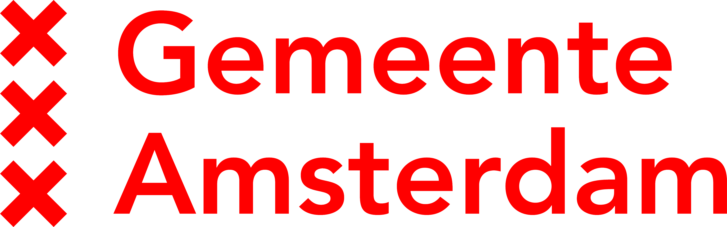


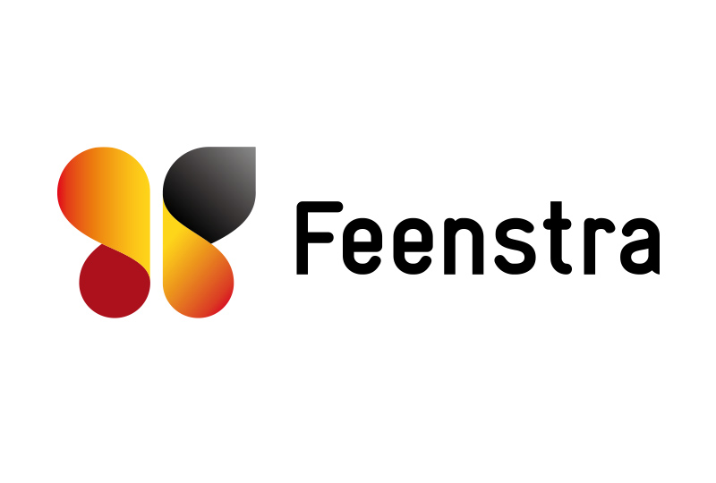

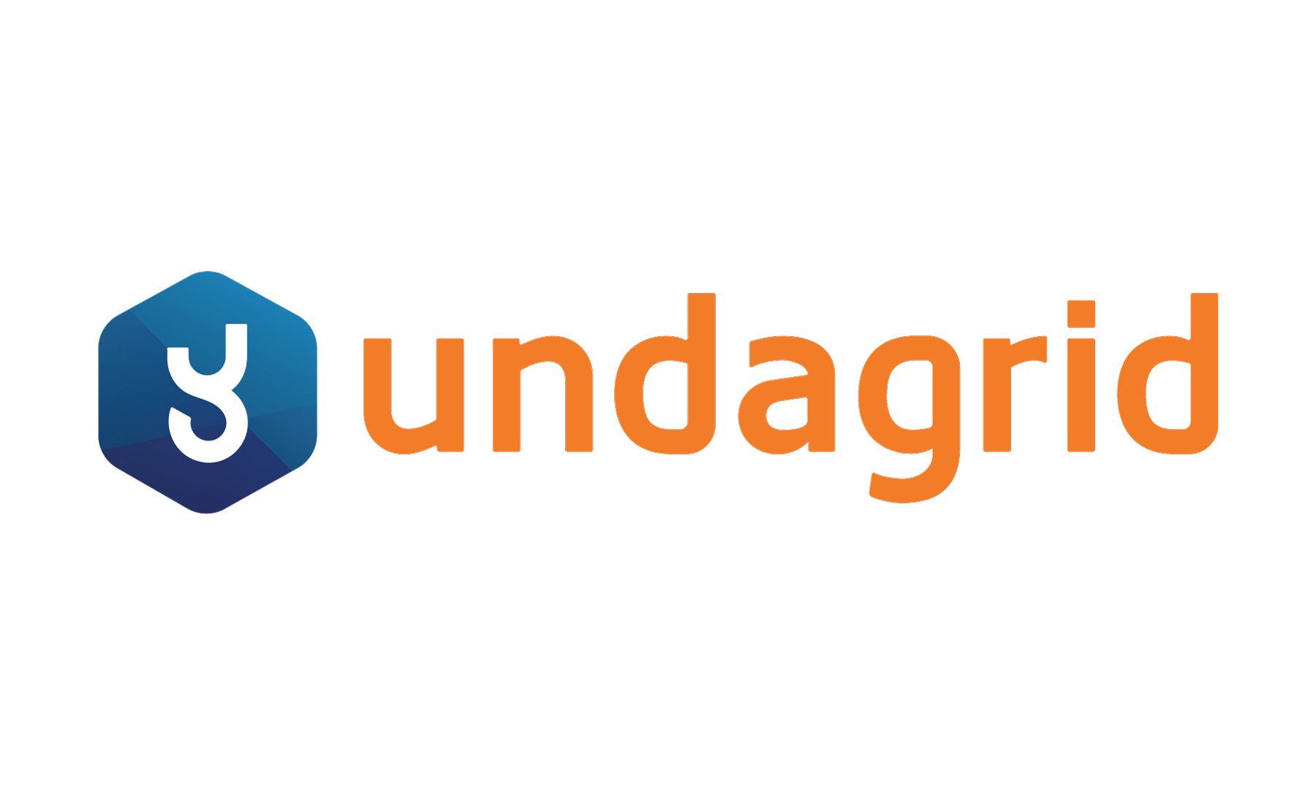









Slide 6












Slide 7
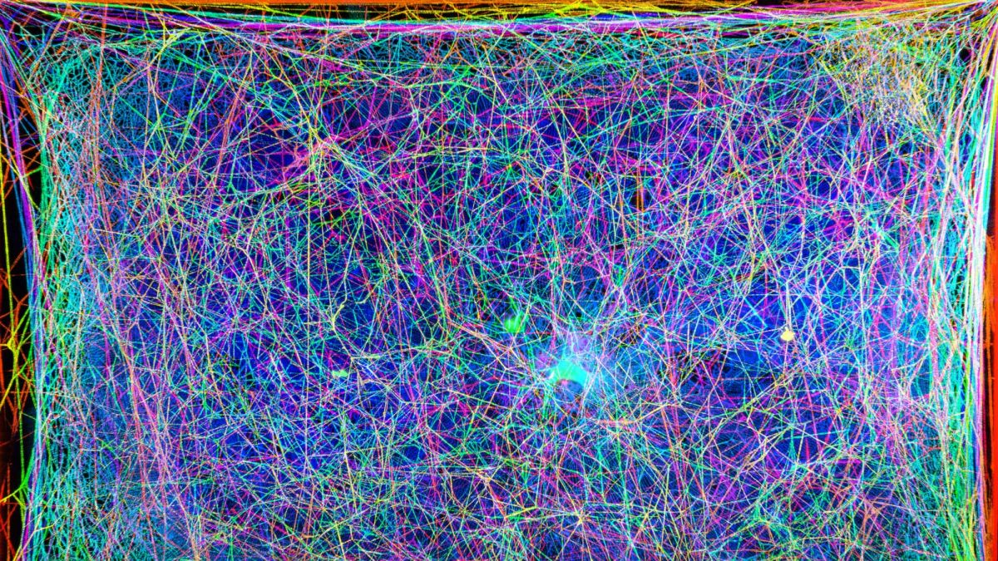





































Slide 8
and you are invited to come do an internship and explore job opportunities with us!

Slide 9

Moving On. Our Main Story today (and next month)
Applications
more specifically: Microservices – the best form of applications we have come up with so far
How they are designed
How they interact
How they can be implemented
Using:
Apache Kafka – distributed message broker, enterprise backbone
Node – popular, full stack, omnipresent programming language
Dapr.io – distributed application runtime

Slide 10

Overview
Part One (today)
Asynchronous communication – Messaging for people and systems
Introducing Apache Kafka – what, why, when, how
Handson with Apache Kafka
Microservices
Quick Intro to programming in Node[.js]
Handson Asynchronous interactions through Node and Apache Kafka
Part Two (next month)
Microservices recap
Dapr.io – personal assistant for applications & distributed application runtime
Multi-microservice with Apache Kafka, Node and Dapr.io

Slide 11

Assumed is
A Gitpod account
Knowledge of
HTTP, REST, JSON
Java or C#
SQL and a database (MySQL or PostgreSQL or SQL Server)
VS Code (or another IDE)
Message Broker/Event Queue (RabbitMQ?), Cache (Redis?)
Containers and Docker (Compose)
Cloud fundamentals
Microservices concepts

Slide 12
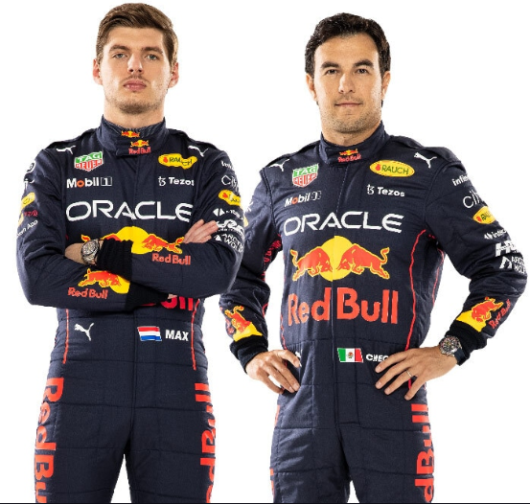




Slide 13

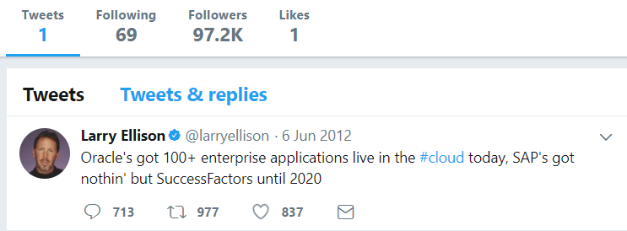
Heck, I do not even know these people and they may not know me [personally] – just my pearls of wisdom. And if they are late to the party, they can also check out the historic archives of my eloquence
Without fretting about the numbers of readers involved and whether they are in the same time zone as me and online when I publish my messages – and which device they use
It would be so nice if I could publish my ideas and actions, accessible near instantly for everyone who is interested

Slide 14
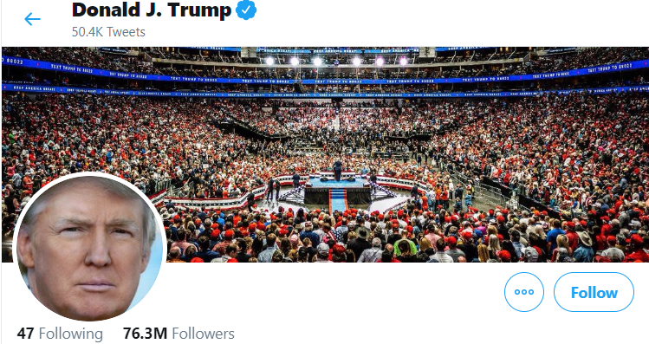
Heck, I do not even know these people and they may not know me [personally] – just my pearls of wisdom. And if they are late to the party, they can also check out the historic archives of my eloquence
Without fretting about the numbers of readers involved and whether they are in the same time zone as me and online when I publish my messages – and which device they use
It would be so nice if I could publish my ideas and actions, accessible near instantly for everyone who is interested

Slide 15
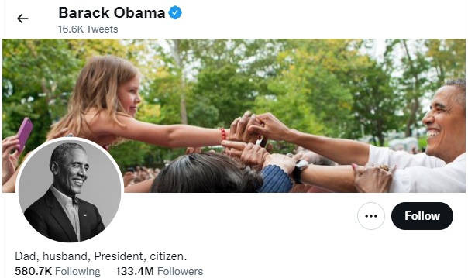
Heck, I do not even know these people and they may not know me [personally] – just my pearls of wisdom. And if they are late to the party, they can also check out the historic archives of my eloquence
Without fretting about the numbers of readers involved and whether they are in the same time zone as me and online when I publish my messages – and which device they use
It would be so nice if I could publish my ideas and actions, accessible near instantly for everyone who is interested

Slide 16

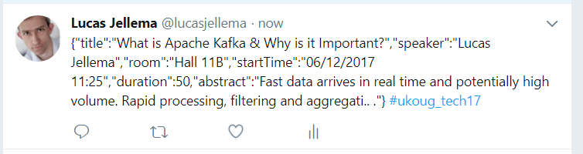
Decoupled communication
0, 1 or many followers
Scalable number of messages (and parties)
Reliable (mostly available, few messages lost)
Full history
Open: cross device, cross location
Not Sub-second, near real-time fast
Rate limited (#messages/minute)
Size limited (140-280 characters)
Format limited (text)
Not for private interactions
Not (really) for programmatic use

Slide 17
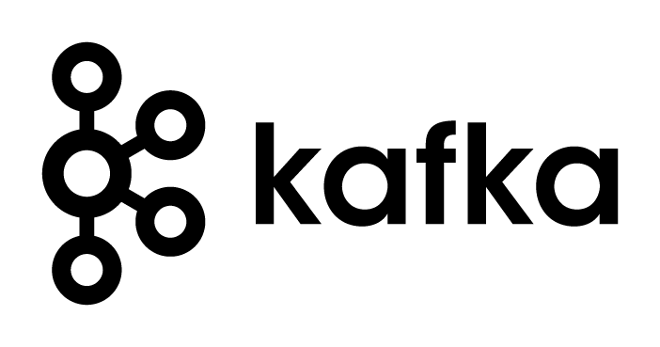
What does the Twitter for System Driven Event Interaction look like?
Decoupled communication – organized per topic
0, 1 or many Consumers per Topic
Scalable number of messages (and parties)
Reliable (distributed)
Full history
Open: libraries in many technologies & REST APIs

Slide 18
What does the Twitter for System Driven Event Interaction look like?
Decoupled communication – organized per topic
0, 1 or many Consumers per Topic
Scalable number of messages (and parties)
Reliable (distributed)
Full history
Open: libraries in many technologies & REST APIs
Near real-time fast
No Rate Limit
No enforced size limit
Anything goes (it’s all byte[])
On premises or in cloud, private or trusted
Very much for programmatic use

Slide 19
Events
Consumers
Producers
Robust, QoS, Scalable, Fast, History Retention
Order preserved
Containerized/Cloud-enabled
Open

Slide 20
Messaging as we know it
JMS, IBM MQ, MS MQ, RabbitMQ, MQTT, XMPP, WebSockets, Apache ActiveMQ, …
Challenges
Costs
Scalability (size and speed)
(lack of) Distribution (and therefore availability)
Complexity of infrastructure
Message delivery guarantees (reliability)
Lack of technology openness
Deal with temporarily offline consumers
Retain history

Slide 21


Introducing Apache Kafka
..- 2010 – creation at Linkedin
Message Bus | Event Broker
High volume, low latency, highly reliable, cross technology
Scalable, distributed, strict message ordering, ….
2011/2012 – open source under the Apache Incubator/ Top Project
Kafka is used by many large corporations:
Walmart, Cisco, Netflix, PayPal, LinkedIn, eBay, Spotify, Uber, Sift Science, Zalando, The New York Times, Airbnb, Coursera, ING Bank,…
… and embraced by many software vendors & cloud providers
Commercial backing by and Enterprise support from Confluent

Slide 22
Consumers
tcp
Producers
tcp
Client polls Event Broker for messages

Slide 23
Consumers
Producers
Topic

Slide 24
Kafka terminology
Topic
Message
== ByteArray
Broker
Producer
Consumer
Offset
Message
Key
Value
Time
Producer
Consumer
Broker
Topic
offset (for a specific consumer)

Slide 25
Key
Value
Time
Consumers
Producers
Broker
Topic

Slide 26
Consuming
Messages are available to consumers only when they have been committed by the producer
Kafka does not push
Unlike JMS
Read does not destroy
Unlike JMS Topic
(some | much | all) History available
Offline consumers can catch up
Consumers can re-consume from the past (just move offset)
Delivery Guarantees
Ordering maintained
At-least-once (per consumer) by default; at-most-once and exactly-once can be implemented

Slide 27

The company bulletin board
!
!
!
!!
!!
“@#”

Slide 28



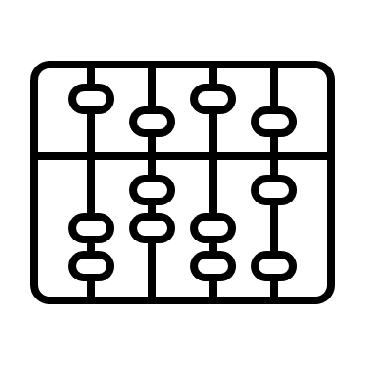

The company bulletin board
!
€
!
!!
“@#$”
$
¥ ₤ ₨

Slide 29
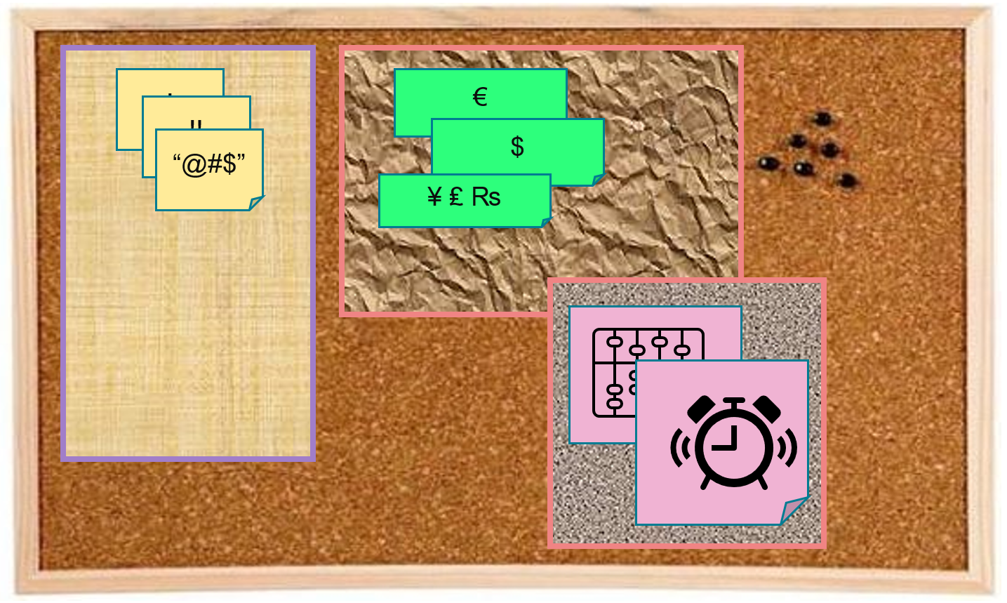
Key
Value
Time
Consumers
Producers
Broker
Topic
Message Log

Slide 30
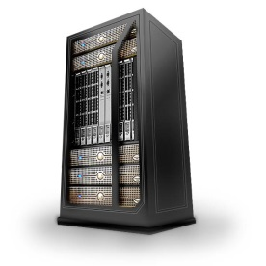

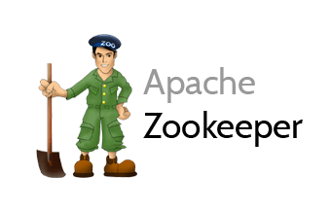
Cluster
Consumers
tcp
Producers
tcp
Broker
Topic

Slide 31
Cluster
Consumers
tcp
Producers
tcp
Broker
Topic
Partition
Consumer Group (team of collaborating consumers)
Partition Log
Replica

Slide 32
Cluster
Consumers
Consumer Group
each consumer group consumes all messages (once)
each consumer in a group consumes from one or more partitions (no partition is consumed by more than one consumer in a group)
when more consumers in a group than partitions in the topic, some consumers get no messages
when consumers disappear from a group, their partition(s) are reassigned to other consumers in the group
Producers
tcp
Broker
Topic
Partition
Consumer Group
Partition Log
Replica

Slide 33
What’s so special?
Durable transactions
Scalable
High volume
High speed
Parallel processing
Available
Distributed
Open
Quick start
Free (no license costs)
“Self Fulfilling Prophecy” leading to “de facto standard” (positive feedback loop feeding from buzz around Kafka)
Eco system, tools/libraries/resources, cloud services

Slide 34
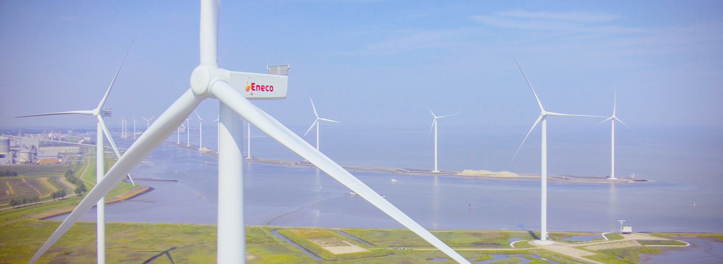
Utility company with data. Lots of it.
Interesting mix of operational, real time systems in physical environments, large scale enterprise systems for 1000s of internal professionals and millions of external consumers – with a mission to improve the world

Slide 35









Utility Company looking for Performance, Scalability and Availability in their core data sets
Marketing Campaigns
Invoicing
CRM
Billing
batch
Meter Readings
Load on Core Systems & effect on Performance
Availability Core Systems

Slide 36
Utility Company looking for Performance, Scalability and Availability in their core data sets
Marketing Campaigns
CRM
Invoicing
CRM Cache DB
Meter Readings
Billing
Meter Readings Cache DB

Slide 37
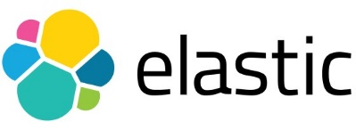
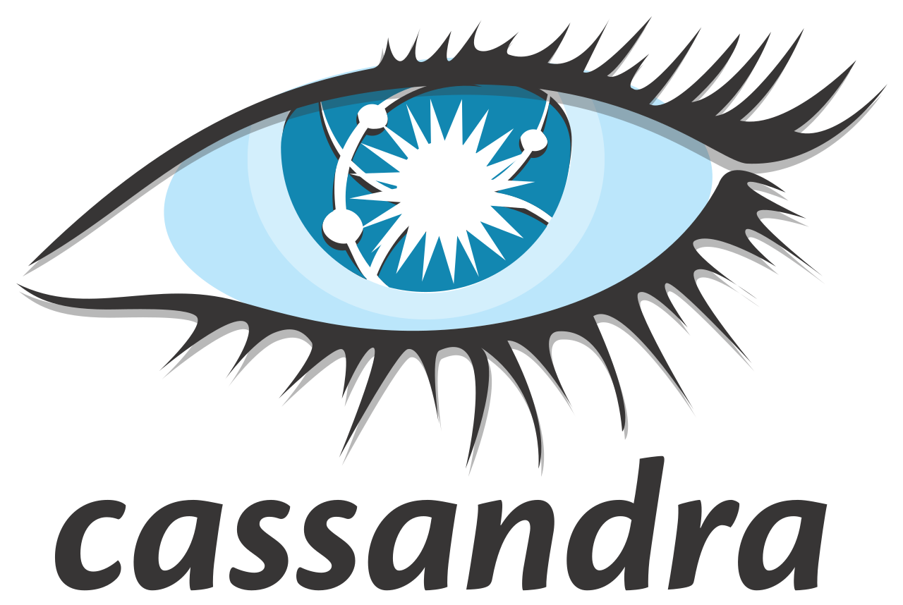
Utility Company looking for Performance, Scalability and Availability in their core data sets
Marketing Campaigns
CRM
Invoicing
CRM Cache DB
Meter Readings
Billing
Meter Readings Cache DB

Slide 38
Other Kafka Consumers
Data Lake
Marketing Campaigns
CRM
Invoicing
CRM Cache DB
Meter Readings
Billing
Meter Readings Cache DB

Slide 39
Practical Challenges
Marketing Campaigns
Publish all change events from sources
Event schema evolution
Lag in Cache Databases
“eventual consistency”
Differences between sources and cache databases
Initial creation of Cache Databases
General Scale and Incidental event storm
Business and Mission Critical availability
Data Authorization
Logic enforced in source (applications)
GDPR
CRM
Invoicing
CRM Cache DB
Meter Readings
Billing
Meter Readings Cache DB

Slide 40

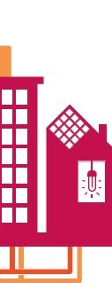

Bridging OT & physical world => Enterprise IT
Monitoring
Validate, Enrich Process, Convert, Publish
Event Streaming Platform
Communication Module
Ingest, Authenticate & Check
Smart Meter
API
Smart Meter
Devices
Telemetry
Actuator
HEAT

Slide 41
Orders of magnitude
Monitoring
150K devices
12M events/day
Validate, Enrich Process, Convert, Publish
Event Streaming Platform
Communication Module
Ingest, Authenticate & Check
Smart Meter
3.5M msg/day
API
Smart Meter
Devices
Telemetry
Actuator
70M records/day
HEAT
70M measurements/day

Slide 42
ING – Fraud detection in ATM transactions
Every ATM transaction request
is handled synchronously – check account, create transaction, …
is published to be evaluated for potential fraud
to a Kafka Topic
fraud detection has 800 ms to put a stop to the transaction
fraud detectors run in a consumer group working in parallel to analyze transactions

Slide 43
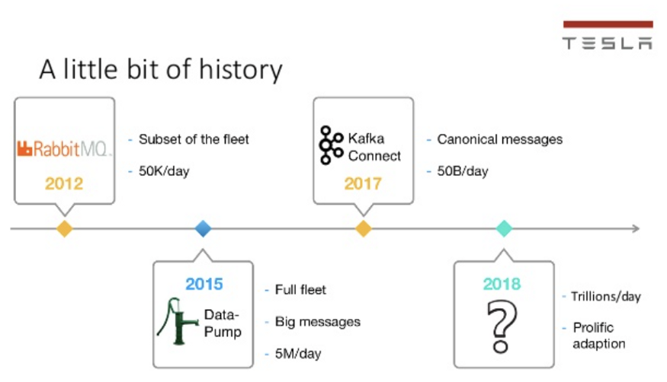
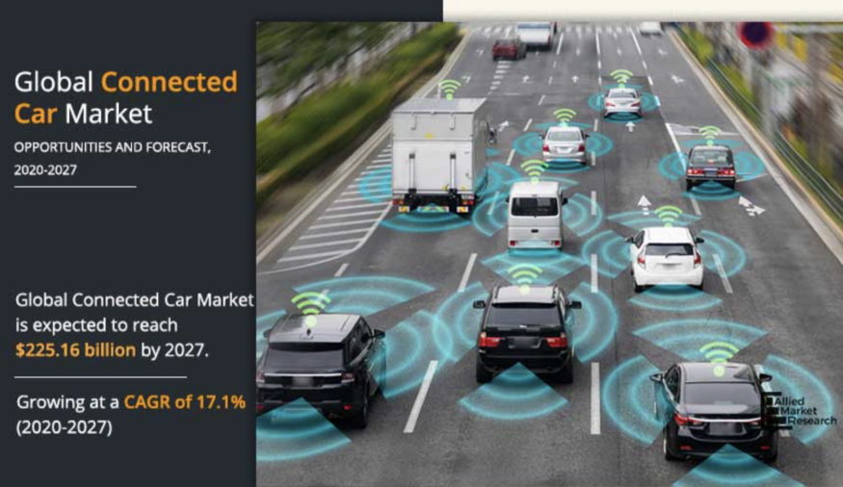
Some Kafka Use Cases
Connected Cars, Manufacturing, Mobility, Gaming, Betting
Tesla: Processing and analyzing the data from their vehicles, smart grids, and factories and integrating with the rest of the IT backend services in real-time is a crucial piece of Tesla’s success
https://kai-waehner.medium.com/when-not-to-use-apache-kafka-a35345226a9f

Slide 44
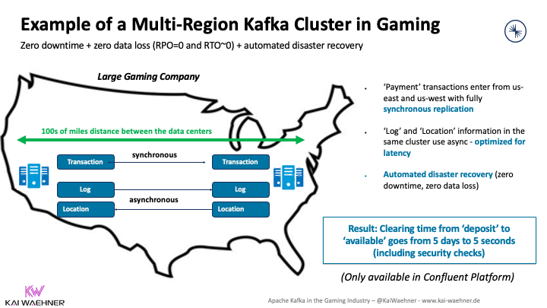
Some Kafka Use Cases
Connected Cars, Manufacturing, Mobility, Gaming, Betting
Regulatory compliance and zero data loss are crucial.
transactionally safe data replication
https://kai-waehner.medium.com/when-not-to-use-apache-kafka-a35345226a9f

Slide 45
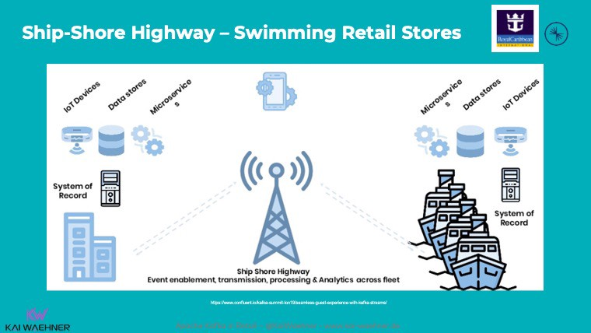
Some Kafka Use Cases
Connected Cars, Manufacturing, Mobility, Gaming, Betting
Royal Caribbean: Each cruise ship has a Kafka cluster running locally for use cases such as payment processing, loyalty information, customer recommendations, etc. Sync with shore when entering a port.
https://kai-waehner.medium.com/when-not-to-use-apache-kafka-a35345226a9f

Slide 46

Quick Demo – Apache Kafka in action
Show interaction at the most basic level
Broker
Topic
single partition
Produce Message
Consume Message
Work with multiple partitions and a Consumer Group
Show AK HQ Web UI
9092
Docker Compose
28042
Browser
Terninal
workspace

Slide 47
Handson – Trying your hand at Apache Kafka
Using Kafka Console and Kafkacat (kcat) CLI
Create a topic
Publish messages to topic
Consume messages from topic
Work with Apache Kafka HQ GUI to
inspect the Kafka Cluster
produce additional messages
Multiple Partitions & Consumer Group
distribution across partitions
parallel message consumption by consumers teaming up in a Consumer Group
9092
Docker Compose
29092
28042
Browser
Terninal
workspace

Slide 48
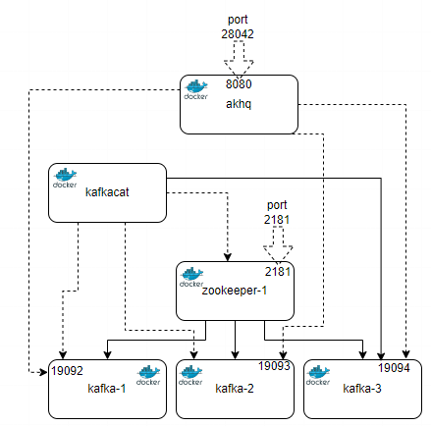
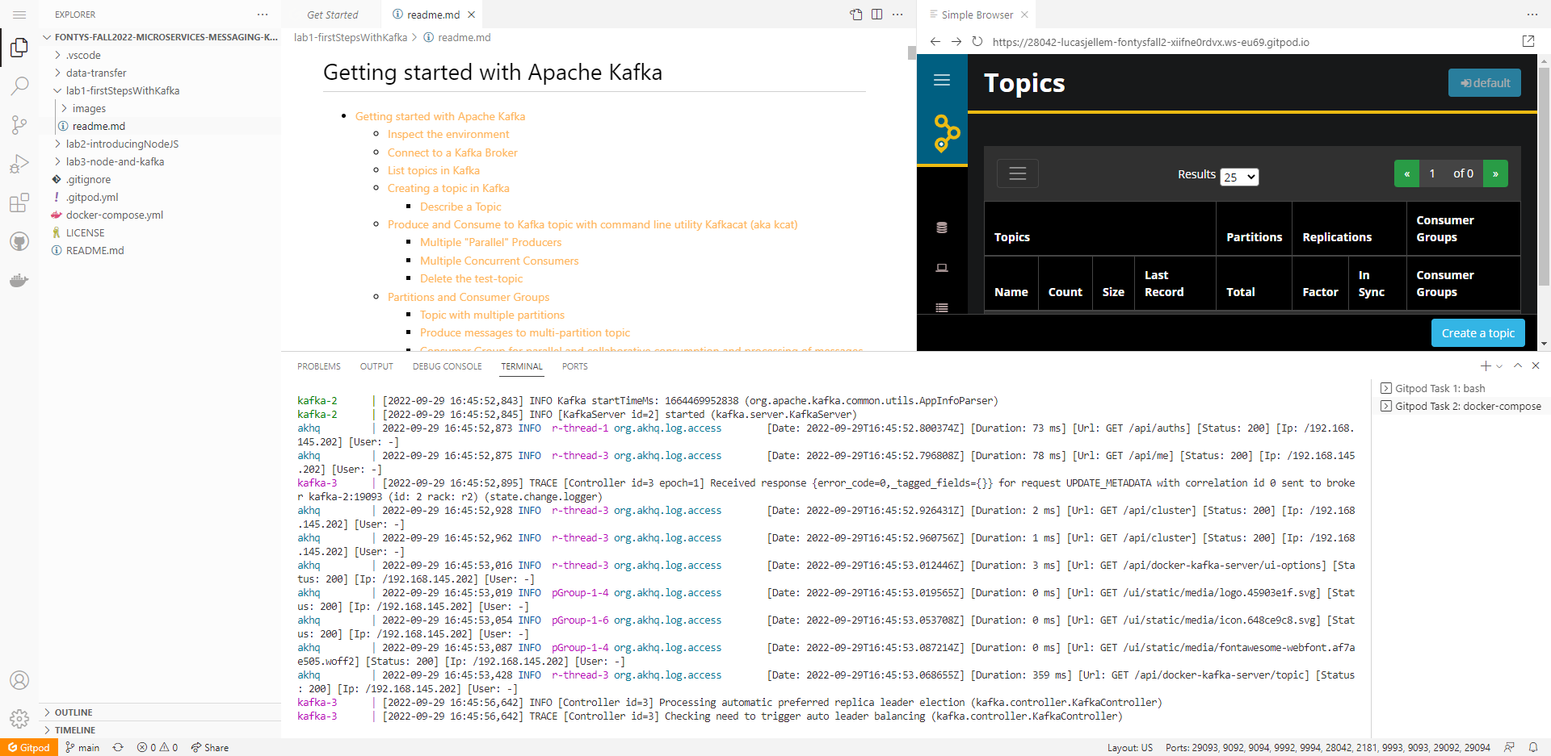
Workshop Environment
Launch GitHub lab repo into Gitpod workspace
GitHub repository: github.com/lucasjellema/fontys-fall2022-microservices-messaging-kafka-dapr
gitpod.io#https://lucasjellema/fontys-fall2022-microservices-messaging-kafka-dapr
workspace

Slide 49
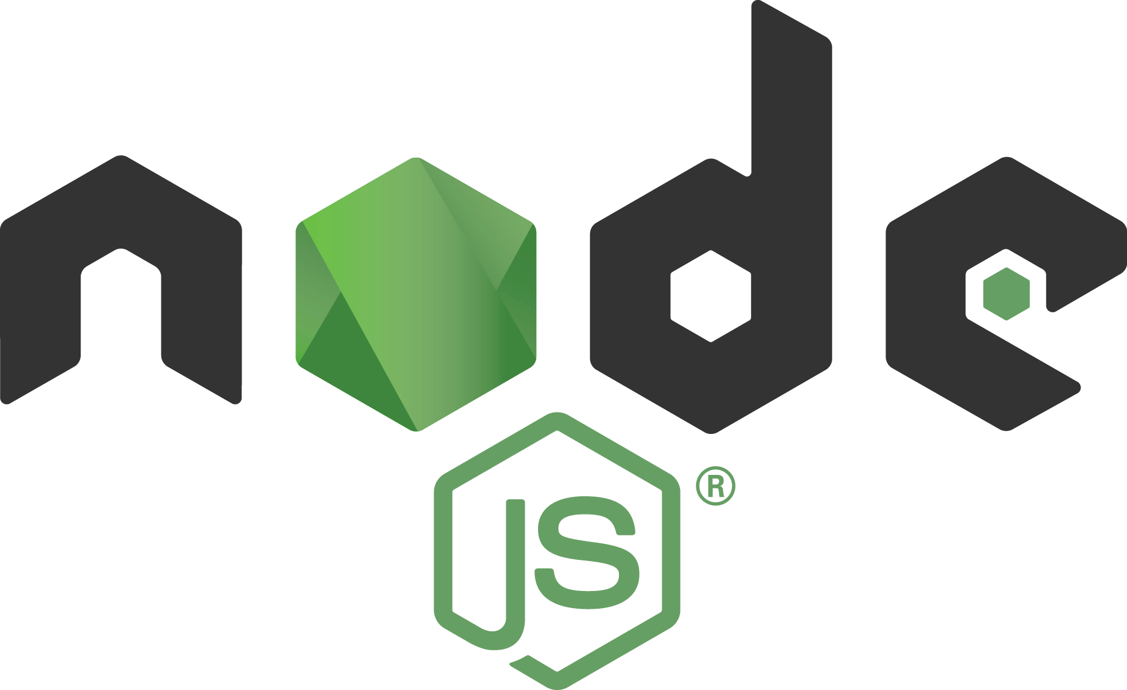
Overview
Introduction to messaging and Apache Kafka
Asynchronous communication – Messaging for people and systems
Introducing Apache Kafka – what, why, when, how
Handson with Apache Kafka
Microservices
Quick Intro to programming in Node[.js]
Handson Asynchronous interactions through Node and Apache Kafka

Slide 50
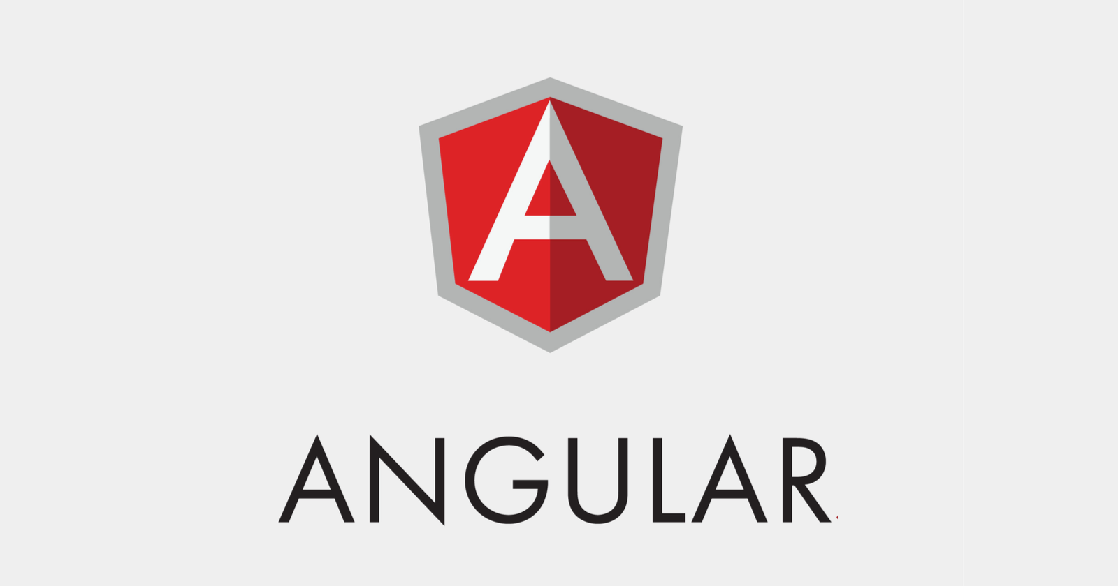










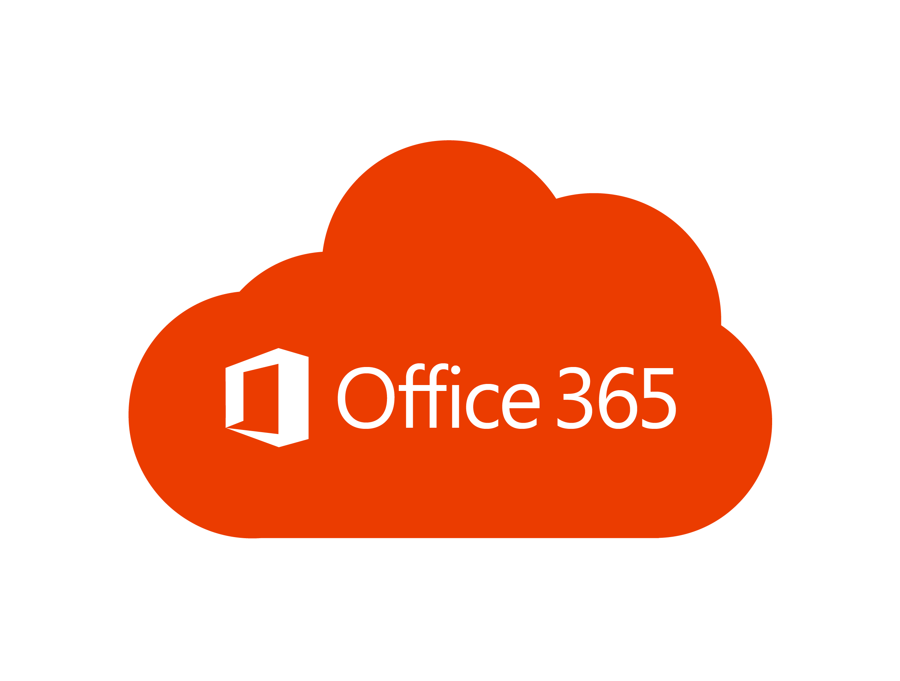
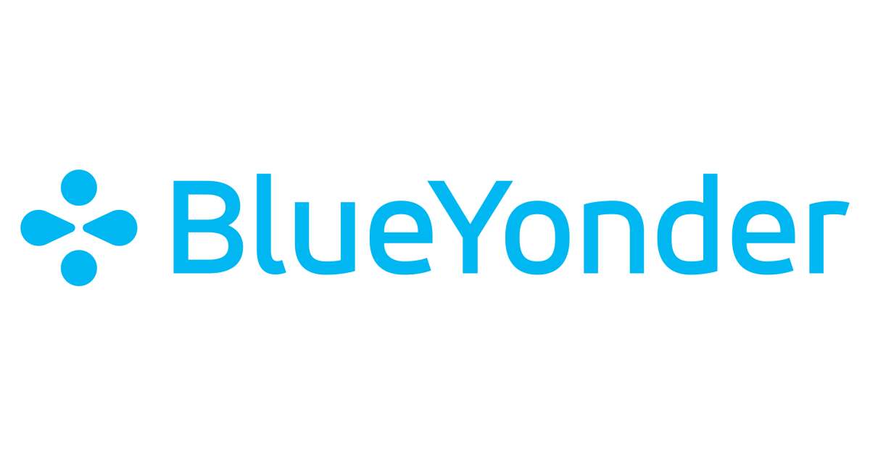

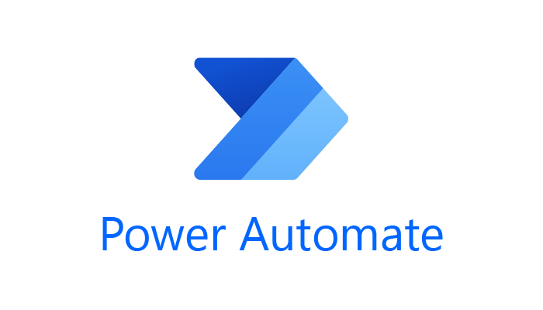

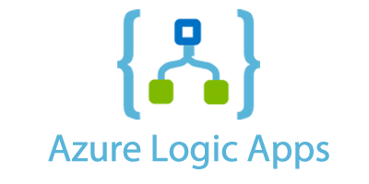

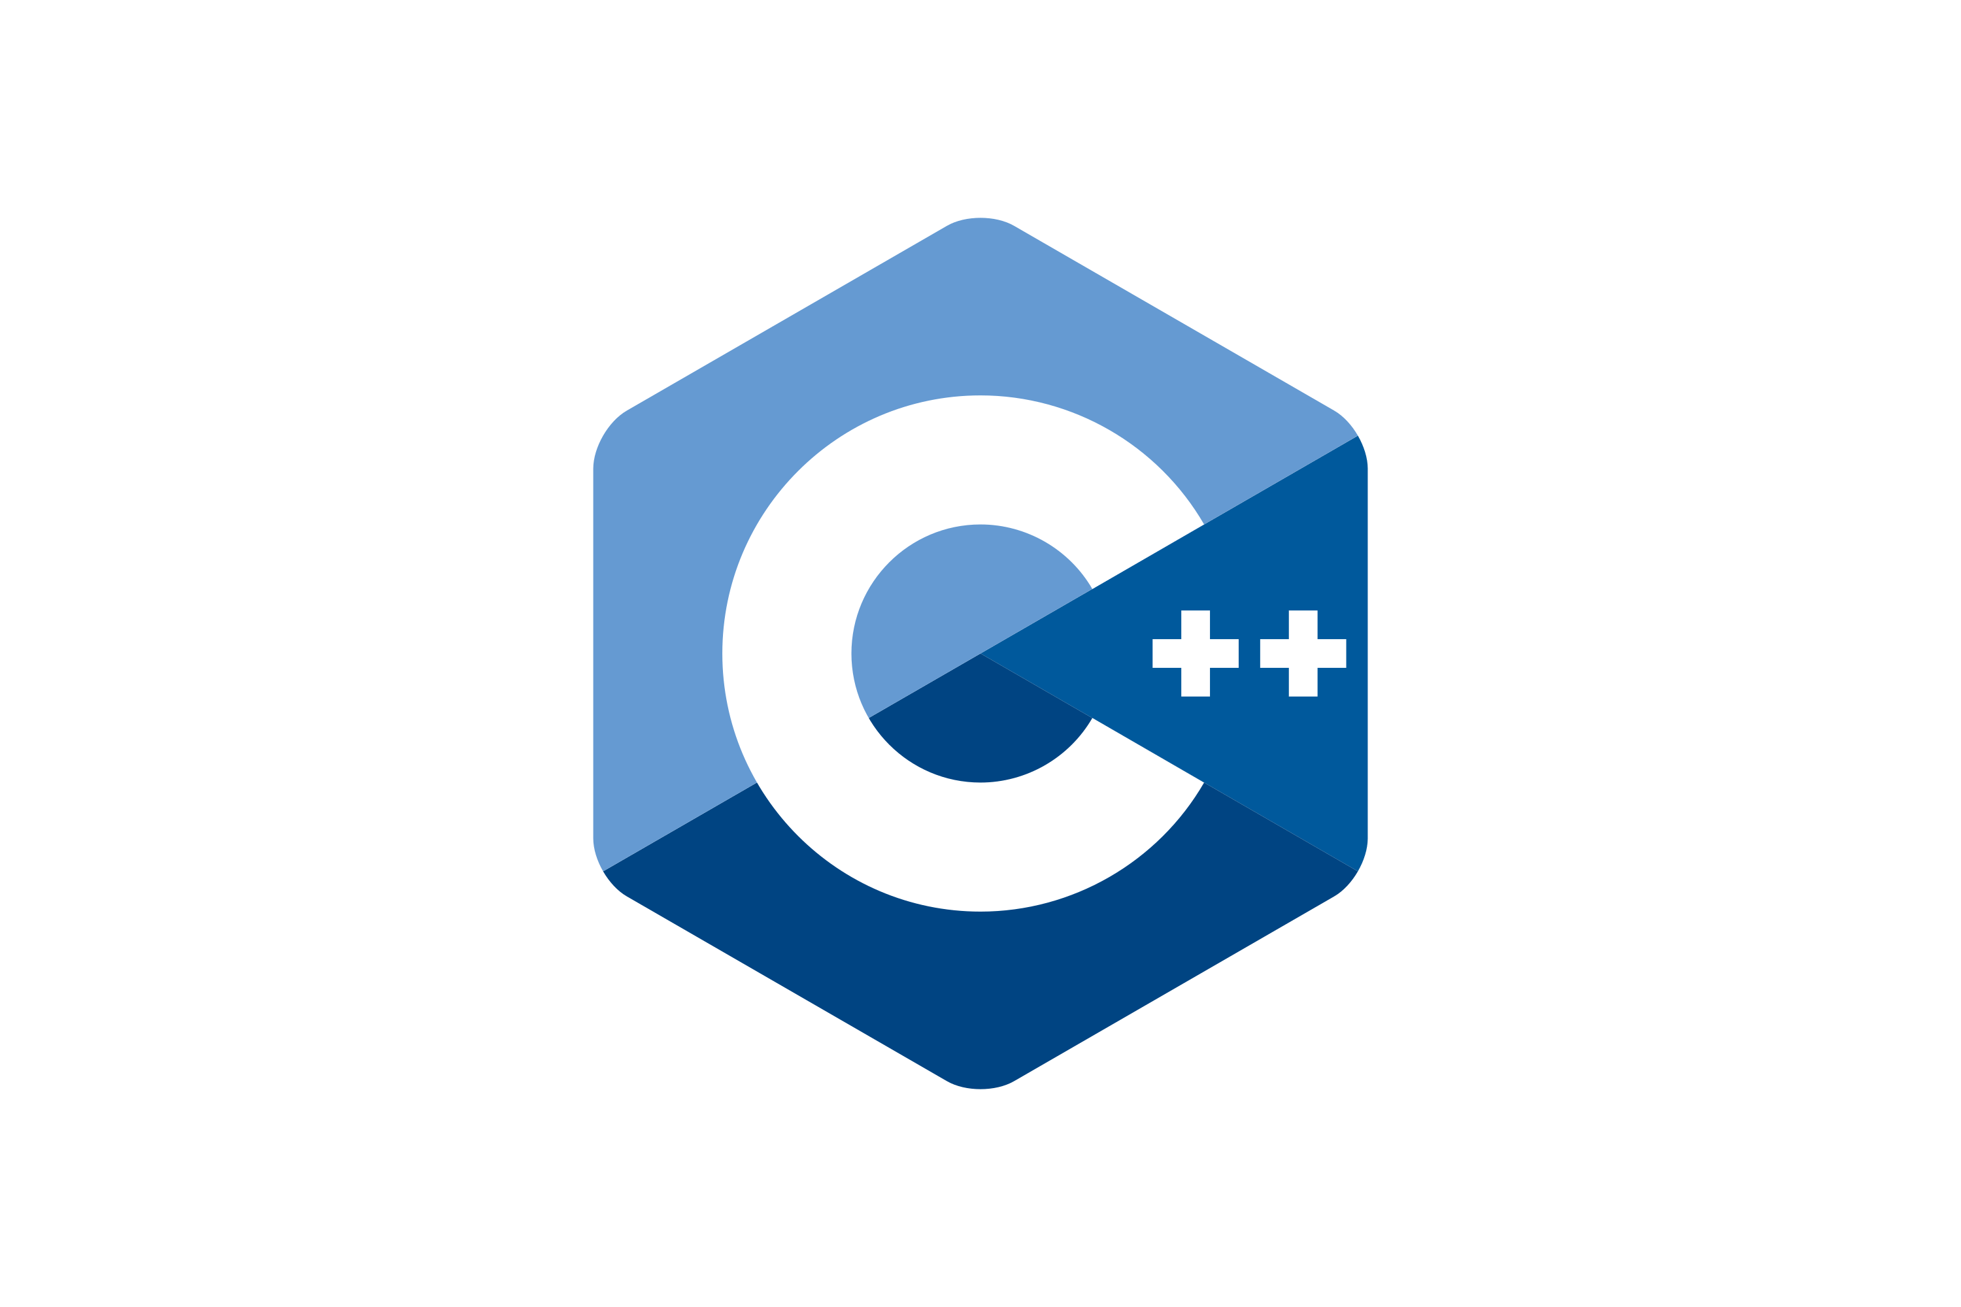











What is an Application?
Collection of (business) functionality
implemented with COTS, code, platform & infra
high code technology for bit & pixel perfect software with tailored fit (functionally & non-functionally)
best of breed applications per functional domain. (custom integration)
low code tools for workflow, automation, integration en frontends
(pre-)integrated application platform, to be custom configured
use as is out of the box
standard
custom
Database
IAM/ LDAP
Event / Message Broker
Web Server
API Gateway
Custom platform
Language Runtime
Operating System
Compute (Containers, VMs, bare metal servers)
Storage
Network
Custom hardware
Data Center
Power
Cooling

Slide 51

What is a microservice?
Why is a microservice?
Problems with (BIG) applications
complex
inflexible to change (when roll out changes)
long test, long build
impossible to upgrade technology (everything is affected)
hard to scale
hard to migrate (to different technology)
hard to learn (for new staff)

Slide 52

Final Demo
Microservices
Microservice

Slide 53
What is a microservice?
Not TOO big (but not too small either)
understandable by normal human beings – easy to on board new team members
easy to change – allow for agile functional and non functional evolution
functionally cohesive/logical collection of features => domain
design time decoupled, clear standards based external interfaces: API & events
low external impact of: change, refactor, move, migrate, scale, failure
reliable, robust, resilient
clear ownership (business sponsor; one IT team builds it, runs it, evolves it)
contains everything needed to run [on a generic platform]
application software, libraries/frameworks, platform configuration
pipelines for CI and CD, tests, documentation, infra as code

Slide 54
What is IT all about?
Production Runtime
Application

Slide 55
What is IT all about?
Production Runtime
Application
Business value
Platform

Slide 56
What is IT all about?
Production Runtime
Operations
Monitoring & Management
Application
Platform
Platform
Platform

Slide 57
Production Runtime is the Result of Preparation Runtime
Preparation Runtime
Production Runtime
Development
Operations
Monitoring & Management
Application
Application
Agile Design, Build, Test
Platform
Platform
CD

Slide 58
One team has Agile responsibility through full lifecyle
Preparation Runtime
Production Runtime
Development
Operations
Monitoring & Management
Application
Application
Agile Design, Build, Test
Platform
Platform
CD

Slide 59
One team has Agile responsibility through full lifecyle
Preparation Runtime
Production Runtime
DevOps
Development
Operations
Monitoring & Management
Application
Application
Agile Design, Build, Test
Platform
Platform
CD
You build it, you run it, you fix it, you evolve

Slide 60
One team has Agile responsibility through full lifecyle
DevOps
Application
Application
Platform
Platform
You build it, you run it, you fix it, you evolve

Slide 61
A microservice is owned by one team through its full lifecyle
DevOps
Microservice
You build it, you run it, you fix it, you evolve

Slide 62
The Microservice
HTTP REST/JSON
API
µ

Slide 63
Extended API of microservice
API
Deployment Interface
Injectable dependencies – reference to cache, logging, storage URL, …
Configurable meta-data – run time parameters, log level, credential (key)
Runtime Interaction Interface
REST API Resources & Operations – query and URL parameters, message formats
Events Consumed – alternative way to call | activate a microservice
Reference to entry in Event Catalog
May include reference to shared Cache Resource
Events Produced – alternative output from microservice
Event can be an asynchronous response to a stateless consumer

Slide 64
Interaction between Microservices
synchronous, route (& discover), retry, load balance, cache, monitor, authorize, TLS
API Gateway
API
API
Event Broker
asynchronous, persistent, reliability guarantees

Slide 65
Interaction between Microservices
API Gateway
API
API
Event Broker

Slide 66
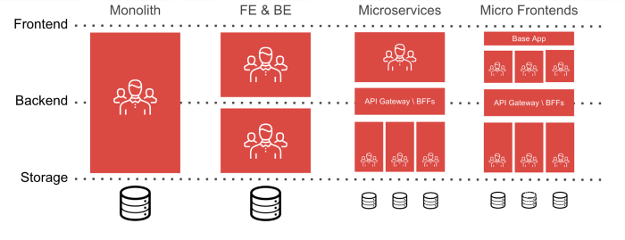
Independent microservices and an integrated front end

Slide 67
Independent microservices and an integrated front end
microservice / team

Slide 68
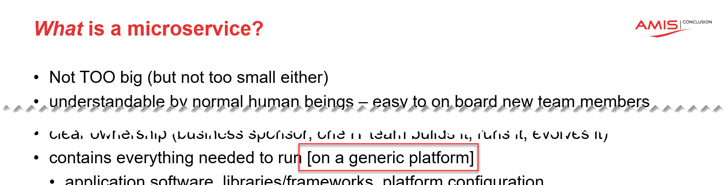
The Microservices Platform
API
API
API
API
µ
µ
µ
µ
Runtime Platform

Slide 69

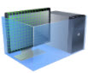



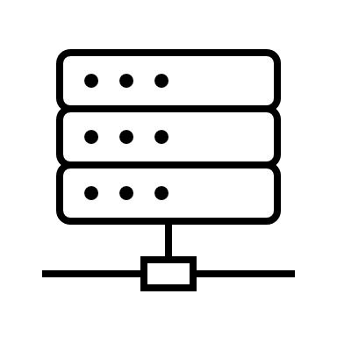
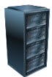
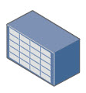
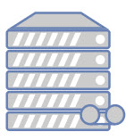


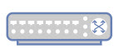








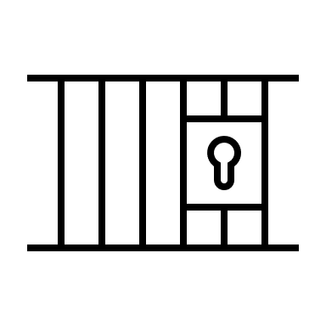
The Microservices Platform
Web Application Firewall
CDN
Load Balancer
API Gateway
API
µ
Job Scheduling
Container Registry
Build & Deploy Pipelines
Container engine
Serverless Functions
Artifact Repository
Code Repository
Virtual Machines
Logging
Monitoring
Auditing
IAM
Vulnerability Scanning
Resource Manager
Cloud Usage Analysis
Cloud Events
APIs
Certificate Management
Notifications
Cloud Guard
Tagging
Search
rack space
power
cooling
physical real estate

Slide 70
The Microservices Platform
Web Application Firewall
CDN
Load Balancer
API Gateway
API
µ
Message/ Event Broker
Job Scheduling
Container Registry
Data Cache
Build & Deploy Pipelines
SQL Database
Data Lake
Serverless Functions
Container engine
NoSQL Database
Artifact Repository
Code Repository
Virtual Machines
Vault
File Storage
Logging
Monitoring
Auditing
IAM
Vulnerability Scanning
Resource Manager
Cloud Usage Analysis
Cloud Events
APIs
Certificate Management
Notifications
Cloud Guard
Tagging
Search
rack space
power
cooling
physical real estate

Slide 71







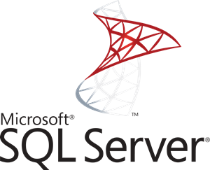

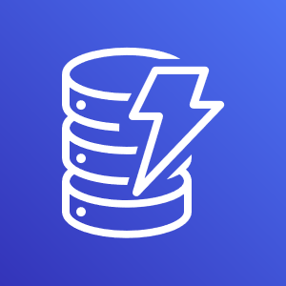
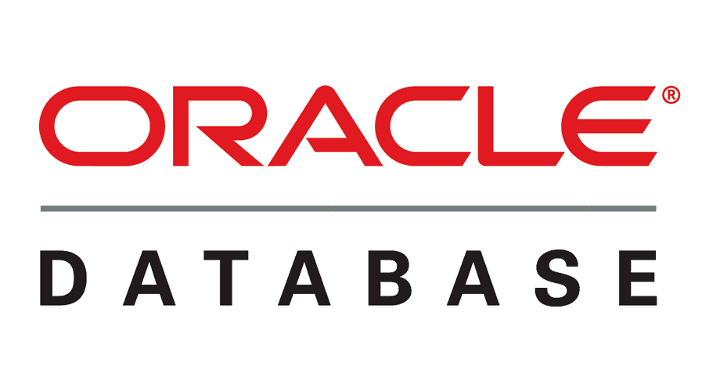
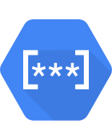
















The Microservices Platform
Web Application Firewall
CDN
Load Balancer
API Gateway
API
AWS
SQS
GCP
Pub/Sub
Redis
µ
Message/ Event Broker
Kafka
Job Scheduling
Azure
Service Bus
Container Registry
Data Cache
RabbitMQ
Build & Deploy Pipelines
Redis
SQL Database
Data Lake
Cassandra
Serverless Functions
Container engine
NoSQL Database
Artifact Repository
Code Repository
Firebase
Virtual Machines
AWS
DynamoDB
Vault
Azure
CosmosDB
GCP
Secret Manager
File Storage
AWS
Secrets Manager
Logging
GCP
Storage
Monitoring
Auditing
AWS
S3
Azure
Storage
Azure
KeyVault
Resource Manager
Zipin
IAM
Vulnerability Scanning
HashiCorp
Vault
Cloud Events
APIs
Cloud Usage Analysis
Certificate Management
Notifications
Cloud Guard
Tagging
Search
rack space
power
cooling
physical real estate

Slide 72
Introduction Node

Slide 73
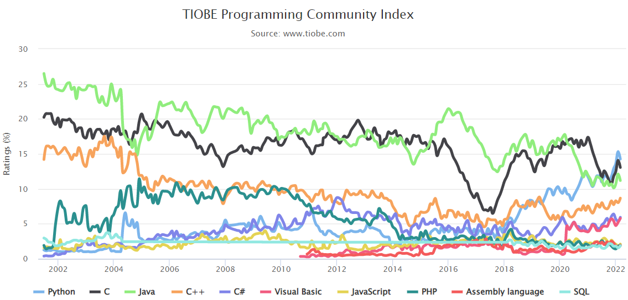
General Purpose Programming Languages
C & C++
COBOL, Fortran, ALGOL, BASIC, Pascal
SmallTalk
Visual Basic
Python
PHP, Perl, Ruby
Java
JavaScript (ECMAScript, ES)
C#
Go
Kotlin
Rust
Notes:
Implementatie van microservices: afhandelen van http requests, consumeren en publiceren van events, doen van http calls: wat zijn activiteiten die iedere microservice moet uitvoeren? (state mgt, pub/sub, secrets, config mgt, aanroepen 3rd party (cloud) services, ..)
Introductie en demo van Dapr.io framework – de personal assistant die iedere applicatie eenvoudig laat aansluiten op generieke voorzieningen én die applicaties (microservices) met elkaar laat interacteren op ontkoppelde wijze; note: ik zal wijzen op de ondersteuning in Dapr.io voor diverse technologieën zoals RabbitMQ, MySQL, Redis
Handson met Dapr – meegeleverde applicaties in Java en C#
Zelf implementeren van microservice – introductie van NodeJS ;
Handson: afbouwen eenvoudige services in NodeJs en via Dapr.io interactie met elkaar en met generieke voorzieningen
College 2 – Kafka als backbone van microservice gebaseerde applicaties, containers & Kubernetes als deployment vehikel en runtime platform
Korte recap – microservices, API & Events, Dapr.io , Kafka;
Intro & Demo van Kafka en plek van Kafka in microservices architecture (en gebruik van Kafka bij grote organisaties)
Handson: interactie met Kafka vanuit eenvoudige NodeJS applicatie
Handson: interactie tussen NodeJS applicaties via Kafka
Kafka via Dapr.io
Handson: microservice pub/sub interactie via Dapr.io sidecar en Kafka; wissel Kafka en Redis base pub/sub (dit kan met NodeJS maar ook met Java of C#)
Handson: microservice binding interactie via Dapr.io sidecar met externe Kafka broker ; studenten kunnen events met elkaars microservices uitwisselen
Intro Kafka Connectors
HerIntro Containers & Kubernetes
Microservices met Containers op Kubernetes plus plek van Dapr.io
Handson:
lokaal draaien van Kubernetes (met minikube of k3s),
Dapr.io op lokaal cluster
Bouw microservice tot Dapr-enabled container en deploy op lokaal cluster; test microservice
Voeg tweede microservice toe die met de eerste interactie heeft
Bonus: horizontaal schalen van eerste service – load balancing door Dapr in aanroepen naar de twee of meer instanties van de eerste service

Slide 74
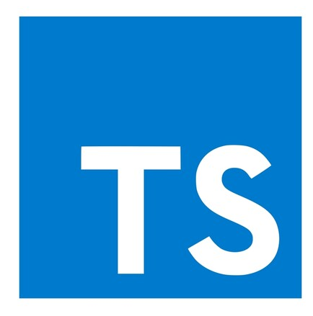
Node == Server Side JavaScript
Script: Not statically typed, not compiled – interpreted at runtime
Node(JS) – open source, runtime based on Chrome V8 JavaScript engine
initial release: 2009
Full stack development – server side and client side can leverage JavaScript
for example: MEAN stack (MongoDB, Express, Angular, NodeJS)
Light weight, quick startup, support for high concurrency
Skills widely available, many resources, tools and libraries
Easy to get started, quite high productivity and fun factor
Functions are primary citizens – functional programming well supported
Quite suitable for microservices – including containerized and serverless
Available everywhere – cross platform, all public clouds
Note: TypeScript compiles to Node that is interpreted at runtime

Slide 75
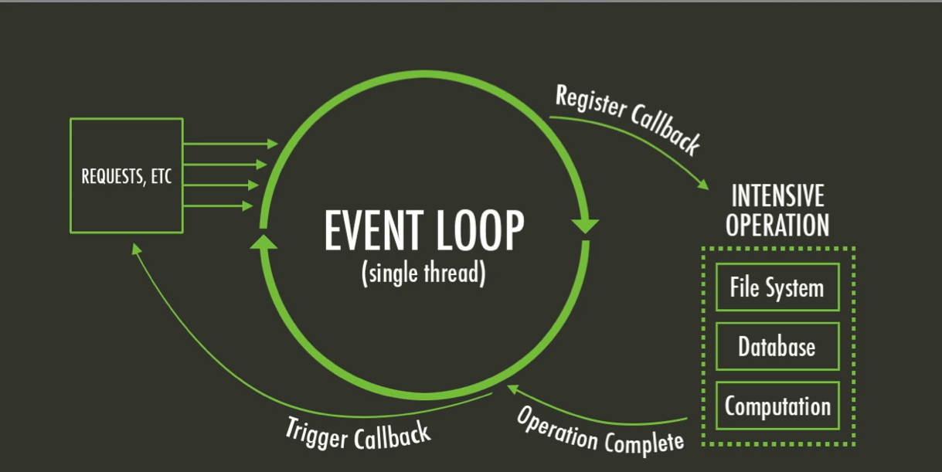
Introducing Node – Single Thread model
Multi-thread languages – such as Java – typically block when file system or network operations take place
Parallel processing continues in parallel threads
Threads consume resources and are only somewhat scalable
JavaScript has a main (single thread) event loop and uses asynchronous processing
Non-blocking handling of file system interactions, HTTP calls, network operations and other blocking actions
Scalable, very quick startup

Slide 76
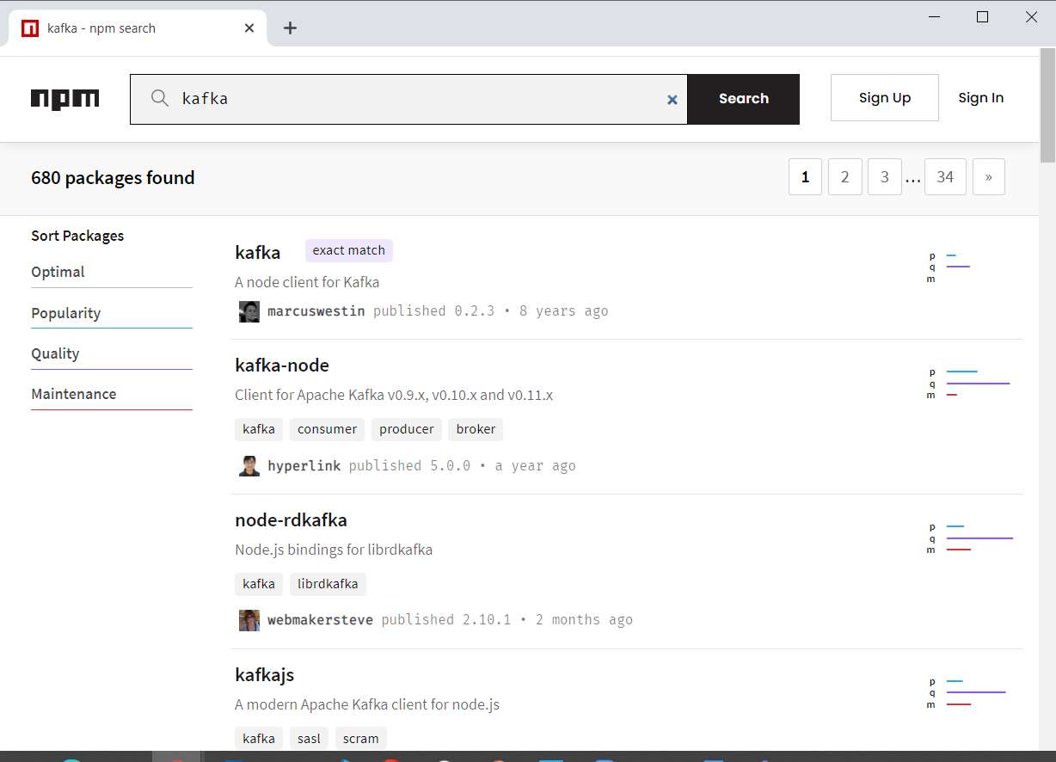
Introducing Node - NPM
NPM = Node Package Manager
To include libraries from the ecosystem
Leverages npm registry (> 1.3M NPM Modules available)
Acquired by Microsoft – March 2020
To build and run Node applications
similar to Maven & Gradle (Java) or pip (Python)
Yarn and Turbo are popular alternatives
Notes:
http://www.modulecounts.com/

Slide 77
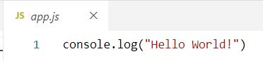
Hello World in Node
app.js
with the code to execute
(optional) package.json
with NPM dependencies, build and run configuration (compare Maven pom.xml)
Create Node application:
npm init (optional, you can just create a text file by hand instead)
Run Node application
node app.js
npm start
Add dependencies
npm install <name of module> --save

Slide 78

Functions
Functions
have a name
take zero, one or multiple untyped input parameters
return zero or one untyped result
or an exception instead of a result

Slide 79


Functions
Function references
can be assigned to a variable
can be passed around
can be invoked
Note: function name without parentheses is not a call to the function but a reference
print vs print()

Slide 80

Functions
Function references can be closures – function + state
closures contain values of local context at the time of instantiation
closure
Hello
1
World
2

Slide 81

Require – to import a module
Node contains many out of the box modules
for example: file, os, http, stream, crypto, net, url
The NPM package manager adds more than 1M modules to make us of
You can create your own (reusable) modules
To access elements from a module, that module needs to be identified, using: const <logical name> = require('module name')
Module name can be reference to a local file, to a global module or to the name of a module defined in package.json (and installed in the application’s node-modules directory)

Slide 82


Node – Asynchronous calls
JavaScript is single threaded – no parallel threads can be started from your code
Any action in Node that requires network or file system interaction is typically performed asynchronously:
the command is started and handed to the Node background processes; the main thread continues with other work
when the background processes have completed the task, the results are returned to the invoker (when the main thread has an opening)

Slide 83


Node – Asynchronous HTTP calls
Many modules are available for HTTP communications from Node
The standard HTTP module is not the most convenient
An HTTP request is processed asynchronously in all cases
main program loop proceeds while request is made
response
asynchronous HTTP request

Slide 84


Asynchronous – waiting for one or more asynchronous results
A function is declared to be asynchronous using the async keyword
The result of an asynchronous function is an object of type Promise
in order to get the actual value – the Promise must be “resolved”
this can be waited for using the keyword await
Alternatively – especially when multiple asynchronous results are waited for at the same time – we can use Promise.then( <callback function>) or Promise.all( <callback function>) to wait for Promise results to come available

Slide 85

Hello World Web Application
Node is very good at handling HTTP Requests
It is a great technology to implement REST APIs and backends for Web and Mobile applications
fast, scalable, easy to develop and to deploy
define the function that handles each HTTP request and prepares the response

Slide 86












Programming against Kafka: Client Libraries
Client libraries
C/C++
Python
Go
Java
.NET
JavaScript/Node
Ruby
Scala
and more..
Also: REST Proxy (part of open source Confluent Platform)
Produce, Consumer and manage through REST API calls
Notes:
https://cwiki.apache.org/confluence/display/KAFKA/Clients

Slide 87
Programming against Kafka: Typical Steps in a Client Producer Application
Create a connection
connected to one or more brokers in a cluster or to the Zookeeper node
you need the broker-endpoints or the Zookeeper endpoint
optionally use credentials or certificate for authentication
Create a Producer on top of the connection
When the Producer-Connection is available…
[Optionally] Start a Transaction
Produce message[s] to topic(s) [or specific topic partition(s)]
[Optionally] Commit the Transaction
[Repeat Message Production]
Disconnect the producer/close the connection
2181
9092
9093
9094
Client
Application
Notes:
https://cwiki.apache.org/confluence/display/KAFKA/Clients

Slide 88
Programming against Kafka: Typical Steps in a Client Consumer Application
Create a connection
connected to one or more brokers in a cluster or to Zookeeper node
you need the broker-endpoints or the Zookeeper endpoint
optionally use credentials or certificate for authentication
Create a Consumer or a ConsumerStream on top of the connection
Subscribing to one or more topics
[Optionally] Associating with a Consumer Group
Which leads to a link to one or more partitions
[Optionally] Overriding the auto-commit
When the Consumer or Stream is available…
Consume message[s] (from the specified subscriptions)
[Optionally, depending on auto-commit poperty] Commit the Transaction
[Repeat Message Consumption]
Disconnect the consumer/close the connection
2181
9092
9093
9094
Client
Application
Notes:
https://cwiki.apache.org/confluence/display/KAFKA/Clients

Slide 89


Node and Kafka
We will use NPM module kafkajs to facilitate the interaction with Apache Kafka from our Node application
This module is small, stand alone and well proven

Slide 90

Node and Kafka – a simple producer

Slide 91

Node and Kafka – a simple producer

Slide 92
Node and Kafka – a simple producer

Slide 93

Node and Kafka – a simple producer

Slide 94
Node and Kafka – a simple producer
1
2
test-topic
9092
9093
9094
2
1
Client
Application

Slide 95

Node and Kafka – a simple consumer

Slide 96
Node and Kafka – a simple consumer
test-topic
29092
29093
29094
2
3
1
Client
Application
1
2
3

Slide 97
Handson Lab 2
Explore Node
hello world
functions
asynchronous
http server – to expose web app and REST API
Explore Node interacting with Apache Kafka
Consume from and Produce messages to Kafka Topic from Node
Multiple producers and some collaborating consumers
From Web UI to Kafka Topic to Web UI/API
labs: github.com/lucasjellema/fontys-fall2022-microservices-messaging-kafka-dapr

Slide 98
Microservices in real life – with Node & Dapr.io & 16 November 2022
Next Month:
Apache Kafka
Lucas Jellema Architect & CTO AMIS | Conclusion
Notes:
Wat is een microservice? (waarom, problemen met monolitische applicaties, hoe microservice architectuur, generieke voorzieningen & platform voor microservices, data & events als glue tussen microservices)
Hier alvast stilstaan bij het belang van een event broker en een korte intro van Kafka (meer in college 2)
Implementatie van microservices: afhandelen van http requests, consumeren en publiceren van events, doen van http calls: wat zijn activiteiten die iedere microservice moet uitvoeren? (state mgt, pub/sub, secrets, config mgt, aanroepen 3rd party (cloud) services, ..)
Introductie en demo van Dapr.io framework – de personal assistant die iedere applicatie eenvoudig laat aansluiten op generieke voorzieningen én die applicaties (microservices) met elkaar laat interacteren op ontkoppelde wijze; note: ik zal wijzen op de ondersteuning in Dapr.io voor diverse technologieën zoals RabbitMQ, MySQL, Redis
Handson met Dapr – meegeleverde applicaties in Java en C#
Zelf implementeren van microservice – introductie van NodeJS ;
Handson: afbouwen eenvoudige services in NodeJs en via Dapr.io interactie met elkaar en met generieke voorzieningen

